Slide 2
And How do I use it?
It’s quite easy. But I need some more space to explain, click NEXT.
HOME
GAME
MODES
BACK
QUIT
PLAYING

Slide 3
HOME
GAME
MODES
BACK
QUIT
PLAYING

Slide 4
HOME
GAME
MODES
BACK
QUIT
PLAYING

Slide 5
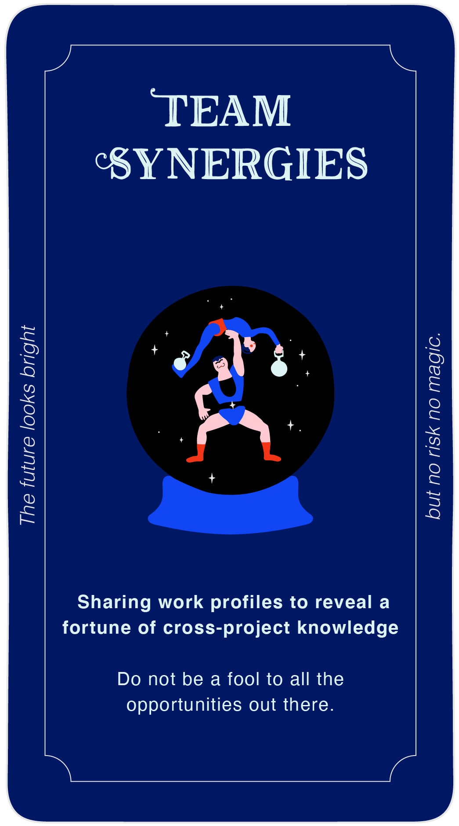
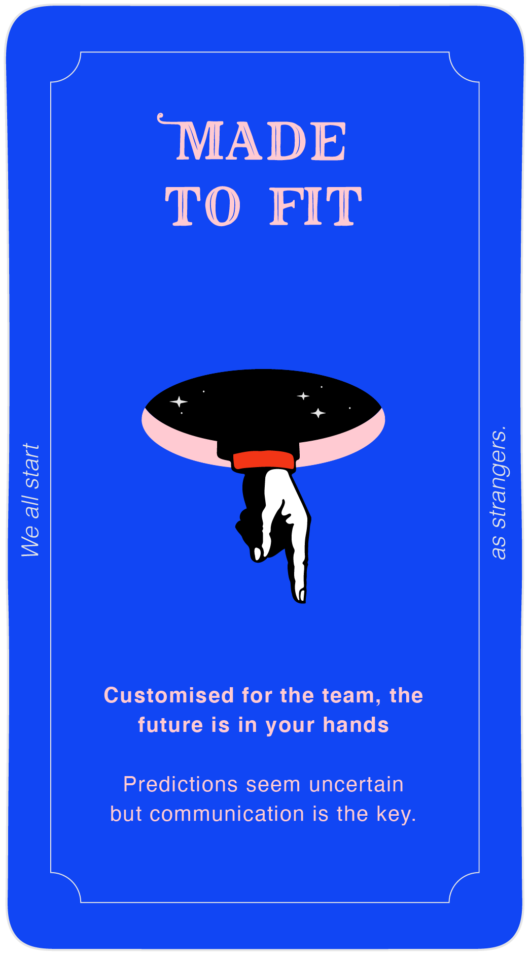
HOME
GAME
MODES
BACK
QUIT
PLAYING

Slide 6
HOME
GAME
MODES
BACK
QUIT
PLAYING

Slide 7
BACK
QUIT
PLAYING

Slide 8
BACK
QUIT
PLAYING

Slide 9
BACK
QUIT
PLAYING

Slide 10
BACK
QUIT
PLAYING

Slide 11
BACK
QUIT
PLAYING

Slide 12
BACK
QUIT
PLAYING

Slide 13
BACK
QUIT
PLAYING

Slide 14
BACK
QUIT
PLAYING

Slide 15
BACK
QUIT
PLAYING

Slide 16
BACK
QUIT
PLAYING

Slide 17
BACK
QUIT
PLAYING

Slide 18
BACK
QUIT
PLAYING

Slide 19
BACK
QUIT
PLAYING

Slide 20
BACK
QUIT
PLAYING

Slide 21
BACK
QUIT
PLAYING

Slide 22
BACK
QUIT
PLAYING

Slide 23
HOME
GAME
MODES
BACK
QUIT
PLAYING

Slide 24
BACK
QUIT
PLAYING

Slide 25
BACK
QUIT
PLAYING

Slide 26
BACK
QUIT
PLAYING

Slide 27
BACK
QUIT
PLAYING

Slide 28
BACK
QUIT
PLAYING

Slide 29
BACK
QUIT
PLAYING

Slide 30
BACK
QUIT
PLAYING

Slide 31
BACK
QUIT
PLAYING

Slide 32
BACK
QUIT
PLAYING

Slide 33
BACK
QUIT
PLAYING

Slide 34
BACK
QUIT
PLAYING

Slide 35
BACK
QUIT
PLAYING

Slide 36
BACK
QUIT
PLAYING

Slide 37
BACK
QUIT
PLAYING

Slide 38
BACK
QUIT
PLAYING

Slide 39
BACK
QUIT
PLAYING

Slide 40
(INSERT NAME)
HOME
GAME
MODES
BACK
QUIT
PLAYING

Slide 41
Instructions:
POINT A
TITTLE
BACK
QUIT
PLAYING
POINT C
POINT B

Slide 42
Instructions:
POINT A
TITTLE
BACK
QUIT
PLAYING
POINT C
POINT B

Slide 43
Instructions:
POINT A
TITTLE
BACK
QUIT
PLAYING
POINT C
POINT B

Slide 44
Instructions:
POINT A
TITTLE
BACK
QUIT
PLAYING
POINT C
POINT B

Slide 45
Instructions:
POINT A
TITTLE
BACK
QUIT
PLAYING
POINT C
POINT B

Slide 46
Instructions:
POINT A
TITTLE
BACK
QUIT
PLAYING
POINT C
POINT B

Slide 47
Instructions:
POINT A
TITTLE
BACK
QUIT
PLAYING
POINT C
POINT B

Slide 48
Instructions:
POINT A
TITTLE
BACK
QUIT
PLAYING
POINT C
POINT B

Slide 49
Instructions:
POINT A
TITTLE
BACK
QUIT
PLAYING
POINT C
POINT B

Slide 50
CREATED BY
Keila Z. Pérez
Play Designer & Research Assistant
Design School Kolding
kzq@dskd.dk
Sune Gudiksen
Associate Professor & Organisational
Games, Design School Kolding
skg@dskd.dk

Slide 51
CLICK’

